Slide 1
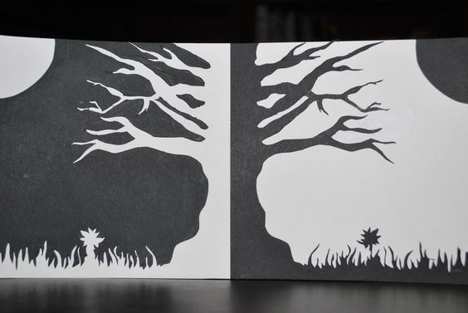
Pozitív- negatív
Spracovala: Mgr. Renáta Kollárová
https://sk.pinterest.com/pin/334673816039301808/

Slide 2

https://sk.pinterest.com/pin/Aa30B0O0Su4pVEOP_S4N9F3ZpRd9fvdkoNqWwV0W1lzYjdt4S7p0JfE/

Slide 3

https://sk.pinterest.com/pin/310889180518332162/

Slide 4

https://sk.pinterest.com/pin/132645151506265948/

Slide 5
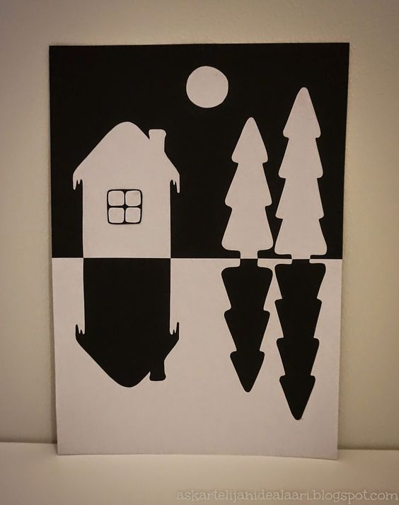
https://sk.pinterest.com/pin/862509766111512064/

Slide 6
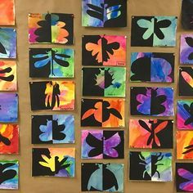
https://sk.pinterest.com/pin/777785798119469411/

Slide 7

https://sk.pinterest.com/pin/482588916314364102/

Slide 8

https://sk.pinterest.com/pin/387309636690168541/

Slide 9

https://sk.pinterest.com/pin/381609768396550755/

Slide 10
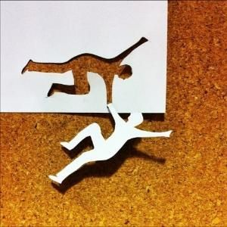
https://sk.pinterest.com/pin/110549365835752302/

